Slide 1
Workshop 7 – Deep Learning – Part 2
Advanced Analytics and Applications [AAA]
Information Systems for Sustainable Society (is3) | WiSo Faculty | Univ.-Prof. Dr. Wolfgang Ketter | 5/19/20

Slide 2
Deep Learning
Outline
1
Classifying newswires
2
Regression with Keras
https://towardsdatascience.com/text-classification-in-keras-part-1-a-simple-reuters-news-classifier-9558d34d01d3
https://medium.com/rocknnull/playing-with-machine-learning-a-practical-example-using-keras-tensorflow-790375cd1abb

Slide 3
Deep Learning
Outline
1
Classifying newswires
2
Regression with Keras
https://towardsdatascience.com/text-classification-in-keras-part-1-a-simple-reuters-news-classifier-9558d34d01d3
https://medium.com/rocknnull/playing-with-machine-learning-a-practical-example-using-keras-tensorflow-790375cd1abb

Slide 4

Classifying newswires with keras
The dataset:Reuters-21578
Sports
Politics
Trade
https://towardsdatascience.com/text-classification-in-keras-part-1-a-simple-reuters-news-classifier-9558d34d01d3
https://medium.com/rocknnull/playing-with-machine-learning-a-practical-example-using-keras-tensorflow-790375cd1abb

Slide 5
Classifying newswires with keras
Fact sheet: Reuters-21578
11228 newswires
Over 46 topics
https://towardsdatascience.com/text-classification-in-keras-part-1-a-simple-reuters-news-classifier-9558d34d01d3
https://medium.com/rocknnull/playing-with-machine-learning-a-practical-example-using-keras-tensorflow-790375cd1abb

Slide 6
Classifying newswires with keras
Fact sheet: Reuters-21578
1. Toy dataset in keras.
2. Each newswire is encoded as a list of word indexes.
3. For convenience, words are indexed by overall frequency in the dataset, so that for instance the integer "3" encodes the 3rd most frequent word in the data.
https://towardsdatascience.com/text-classification-in-keras-part-1-a-simple-reuters-news-classifier-9558d34d01d3
https://medium.com/rocknnull/playing-with-machine-learning-a-practical-example-using-keras-tensorflow-790375cd1abb

Slide 7
Classifying newswires with keras
Our objective: Train a deep learning network that can classify unseen documents
https://towardsdatascience.com/text-classification-in-keras-part-1-a-simple-reuters-news-classifier-9558d34d01d3
https://medium.com/rocknnull/playing-with-machine-learning-a-practical-example-using-keras-tensorflow-790375cd1abb

Slide 8
Classifying newswires with keras
Our objective: Train a deep learning network that can classify unseen documents
Node
Node
Node
Node
Node
Node
Node
Node
Node
Node
Node
Node
Input Layer with 10000 Input Nodes
https://towardsdatascience.com/text-classification-in-keras-part-1-a-simple-reuters-news-classifier-9558d34d01d3
https://medium.com/rocknnull/playing-with-machine-learning-a-practical-example-using-keras-tensorflow-790375cd1abb

Slide 9
Classifying newswires with keras
Our objective: Train a deep learning network that can classify unseen documents
Node
Node
Node
Node
Node
Node
Node
Node
Node
Node
Node
Node
64 Nodes, 2 Hidden Layers, Activation Function: ReLU
https://towardsdatascience.com/text-classification-in-keras-part-1-a-simple-reuters-news-classifier-9558d34d01d3
https://medium.com/rocknnull/playing-with-machine-learning-a-practical-example-using-keras-tensorflow-790375cd1abb

Slide 10
Classifying newswires with keras
Our objective: Train a deep learning network that can classify unseen documents
Node
Node
Node
Node
Node
Node
Node
Node
Node
Node
Node
Node
46 Nodes, 1 Output Layer, Activation Function: SoftMAX
https://towardsdatascience.com/text-classification-in-keras-part-1-a-simple-reuters-news-classifier-9558d34d01d3
https://medium.com/rocknnull/playing-with-machine-learning-a-practical-example-using-keras-tensorflow-790375cd1abb

Slide 11
Deep Learning
Outline
1
Classifying newswires
2
Regression with Keras
https://towardsdatascience.com/text-classification-in-keras-part-1-a-simple-reuters-news-classifier-9558d34d01d3
https://medium.com/rocknnull/playing-with-machine-learning-a-practical-example-using-keras-tensorflow-790375cd1abb

Slide 12
Regression with Keras
The boston housing price data set
Price of House?
https://towardsdatascience.com/linear-regression-on-boston-housing-dataset-f409b7e4a155

Slide 13
Regression with Keras
The boston housing price data set
Sample contains 404 training and 102 test samples.
13 attributes (independent variables) – i.e., attributes of the houses at different location
The target value are the median values of the houses at a location (in k $)
https://towardsdatascience.com/linear-regression-on-boston-housing-dataset-f409b7e4a155

Slide 14
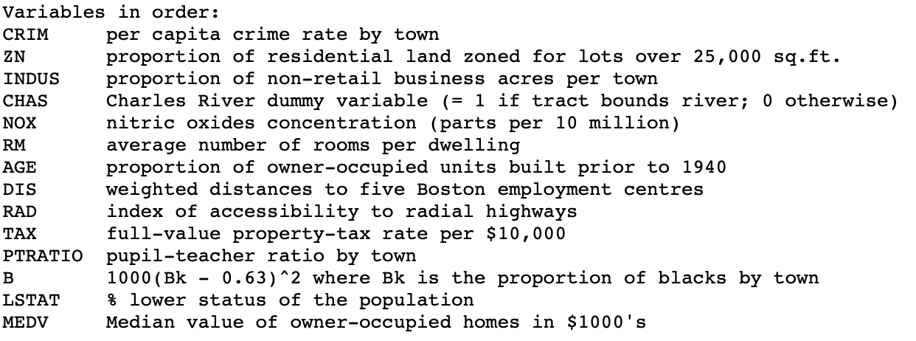
Regression with Keras
The boston housing price data set
https://towardsdatascience.com/linear-regression-on-boston-housing-dataset-f409b7e4a155

Slide 15
Regression with Keras
The boston housing price data set
The attributes have different scales and ranges.
We need to normalize this before training the network.
https://towardsdatascience.com/linear-regression-on-boston-housing-dataset-f409b7e4a155

Slide 16
Regression with Keras
Our objective: Train a deep learning network that can predict house prices
Node
Node
Node
Node
Node
Node
Node
Node
Node
Input Layer with 13 Input Nodes
https://towardsdatascience.com/text-classification-in-keras-part-1-a-simple-reuters-news-classifier-9558d34d01d3
https://medium.com/rocknnull/playing-with-machine-learning-a-practical-example-using-keras-tensorflow-790375cd1abb

Slide 17
Regression with Keras
Our objective: Train a deep learning network that can predict house prices
Node
Node
Node
Node
Node
Node
Node
Node
Node
2 Hidden Layers, 64 Nodes in each layer Activation Function: ReLU
https://towardsdatascience.com/text-classification-in-keras-part-1-a-simple-reuters-news-classifier-9558d34d01d3
https://medium.com/rocknnull/playing-with-machine-learning-a-practical-example-using-keras-tensorflow-790375cd1abb

Slide 18
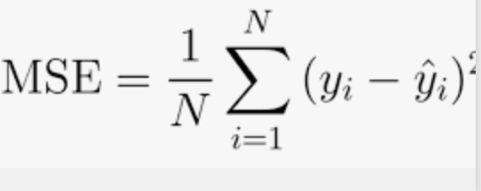
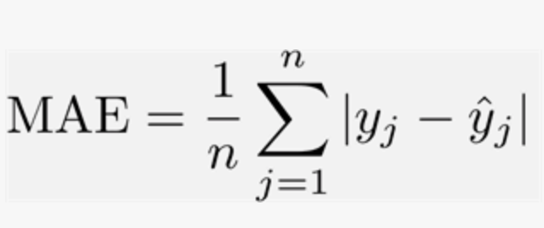
Regression with Keras
Our objective: Train a deep learning network that can classify unseen documents
Loss: MSE
Metric: MAE
Node
Node
Node
Node
Node
Node
Node
Node
Node
1 Output Node, Real Value Output Activation Function: Linear
https://towardsdatascience.com/text-classification-in-keras-part-1-a-simple-reuters-news-classifier-9558d34d01d3
https://medium.com/rocknnull/playing-with-machine-learning-a-practical-example-using-keras-tensorflow-790375cd1abb

Slide 19
Deep Learning
Outline for next week
1
Classifying newswires
2
Regression with Keras
3
Regularization Techniques
https://towardsdatascience.com/text-classification-in-keras-part-1-a-simple-reuters-news-classifier-9558d34d01d3
https://medium.com/rocknnull/playing-with-machine-learning-a-practical-example-using-keras-tensorflow-790375cd1abb

Slide 20
Contact
For general questions and enquiries on research, teaching, job openings and new projects refer to our website at www.is3.uni-koeln.de
For specific enquiries regarding this course contact us by sending an email to the IS3 teaching address at is3-teaching@wiso.uni-koeln.de

